Slide 1
Atmospheric Turbulence Simulation
Nicholas Mateus

Slide 2
What I have been working on
Atmospheric Turbulence Simulation – what does turbulence do to a propagating wave?
Wave propagation using Fresnel Diffraction
Adapting work produced in “Numerical Simulation of Optical Wave Propagation With examples in MATLAB”
Python vs Matlab
GTX 3070, parallelization, memoization, Tensorflow
High resolution phase screens

Slide 3
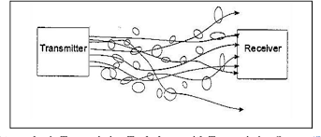
Atmospheric Turbulence
Chaotic air flow
Determined by wind, temperature, altitude, land masses
Atmospheric turbulence causes random fluctuations in refractive index – which is bad for optical communication links

Slide 4
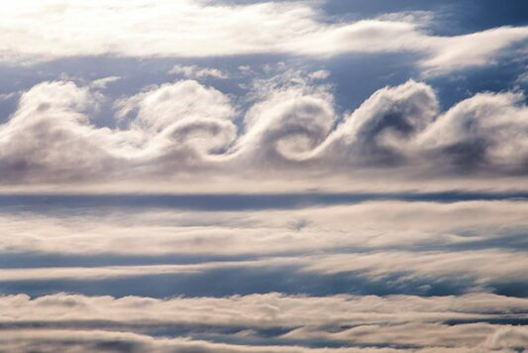
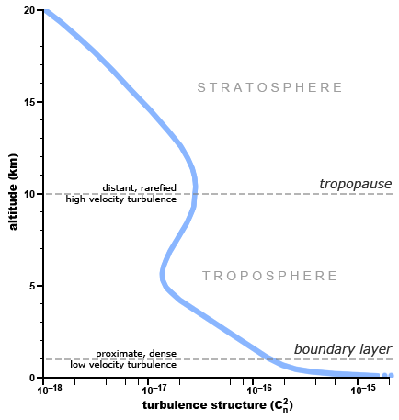
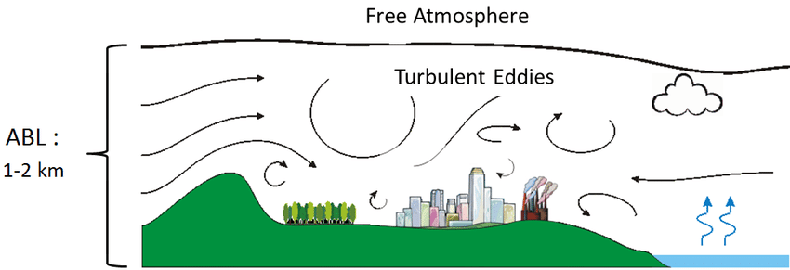
Atmospheric Turbulence

Slide 5
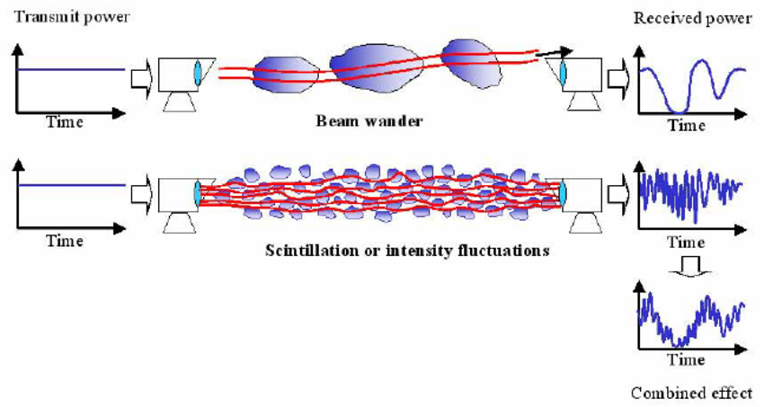
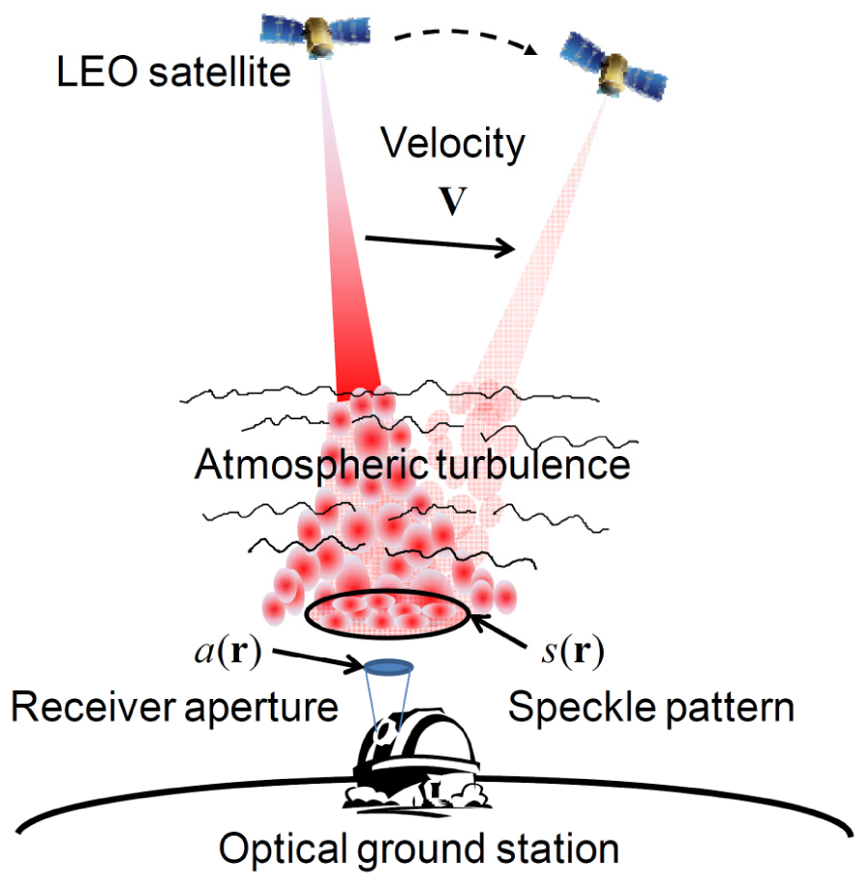
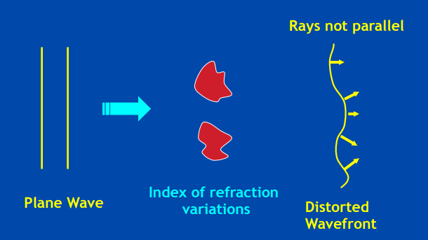
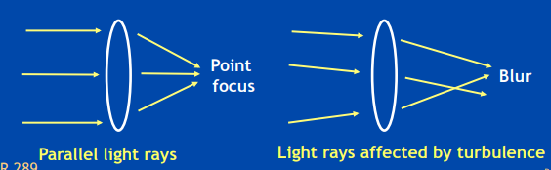
How Turbulence Effects Optical Links

Slide 6
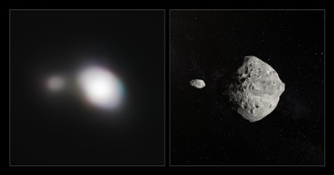
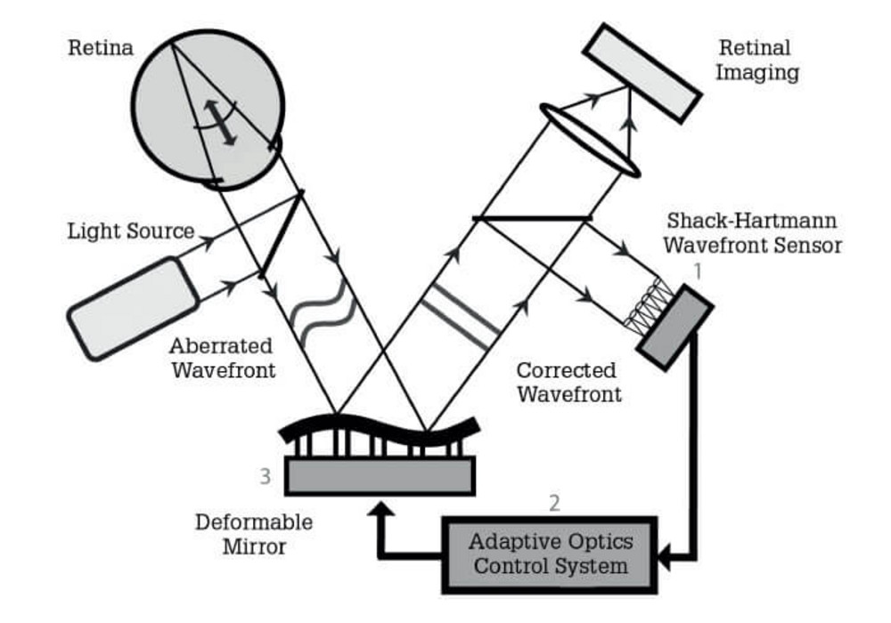
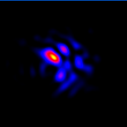
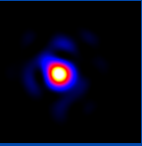
Mitigation of Atmospheric Turbulence
Mitigation:
Ground station elevation
Time of day
Use Adaptive Optics

Slide 7
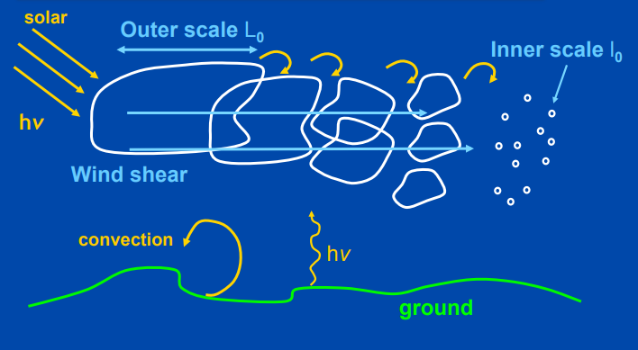
Kolmogorov Theory of Turbulence
Inertial Range (L₀: 100 m, l₀: 1 mm)
Turbulence is assumed to be:
Incompressible
Homogeneous
Isotropic
Stationary in time

Slide 8
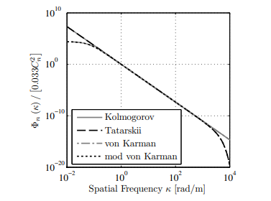
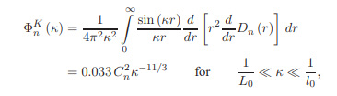
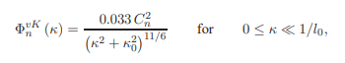
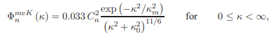
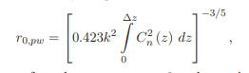
PSD and Parameters
Refractive index PSD
Kolmogorov
von Karman
Modified von Karman
m = -5/3
Parameters
C_{n}² | Refractive-index structure parameter
r₀ | Coherence Diameter (where phase correlation drops off by 1/e)
(D/r₀)² | Telescope / coherence diameter -> measure of how “bad” the turbulence is

Slide 9
How is turbulence simulated?
Distorted wavefront is just the input plane wave with “random” phase adjustments – phase screens
“Randomness” needs to be statistically manipulated
Turbulence can be characterized by statistical averages – structure function, power spectrum of refractive index

Slide 10
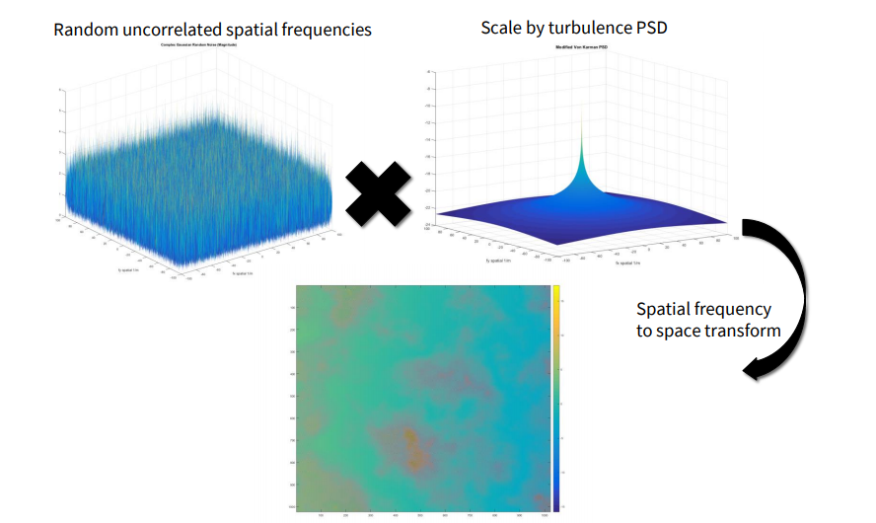
Phase Screen Generation

Slide 11
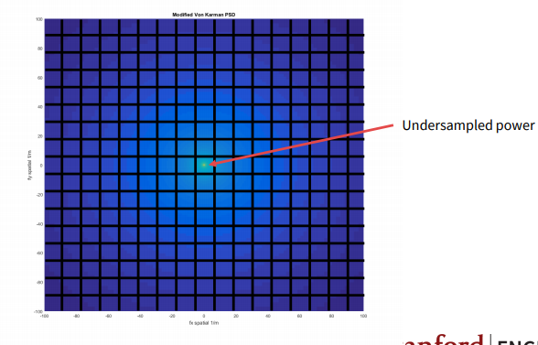
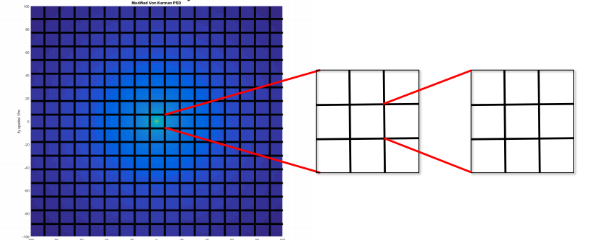
Issues with FT method
Atmospheric PSD contains majority of the power in low spatial frequencies
Linear sampling will underestimate turbulence
Solution: Subharmonic method

Slide 12
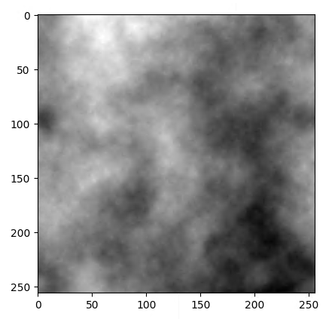
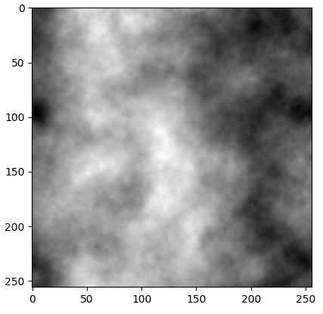
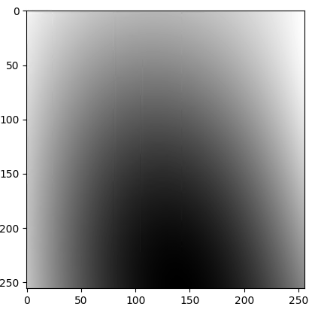
Phase Screen Generation Method
Computationally Efficient & Statistically Accurate Phase Screen
FT method
Sub harmonic method

Slide 13
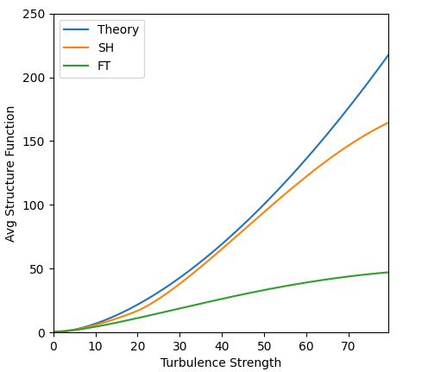
Turbulent Phase Screen Accuracy

Slide 14
Phase Screen Generation - Performance
Hardware | Parallelization/ Memoization? | Num Screens | N x N | Time
CPU | No | 100 | 2048 x 2048 | >60s
GPU | No | 100 | 2048 x 2048 | 15s
GPU | Yes | 100 | 2048 x 2048 | 1.5s
GPU | No | 1000 | 2048 x 2048 | >60s
GPU | Yes | 1000 | 2048 x 2048 | 7s
GPU: GTX 3070 (5 GB available ram)

Slide 15
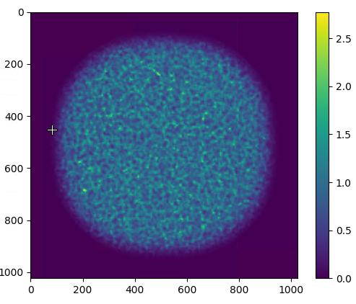
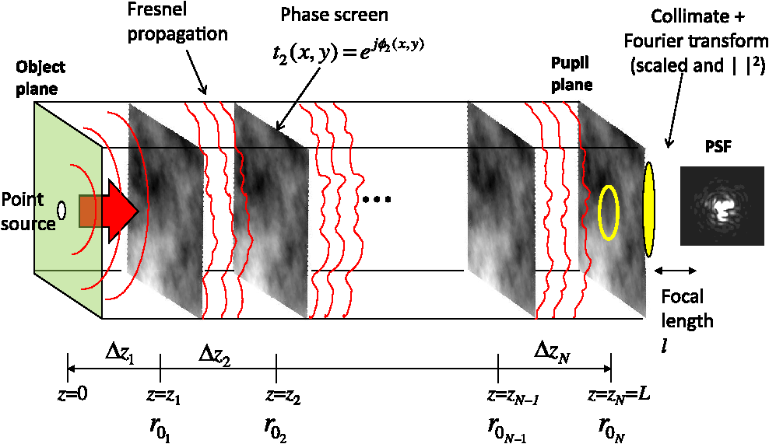
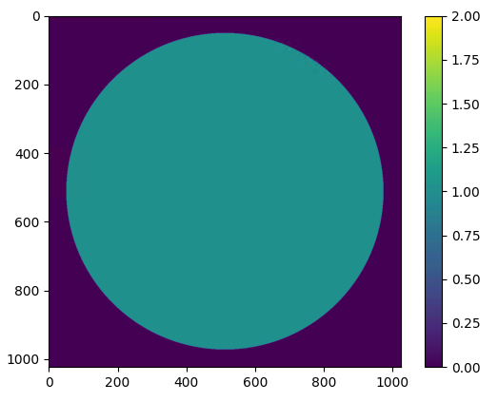
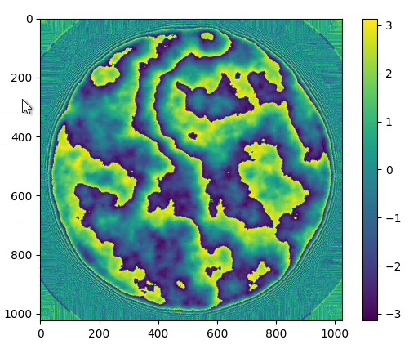
Propagation
11 phase screens (2048x2048)
1km propagation distance
~ 3 seconds end-to-end runtime

Slide 16
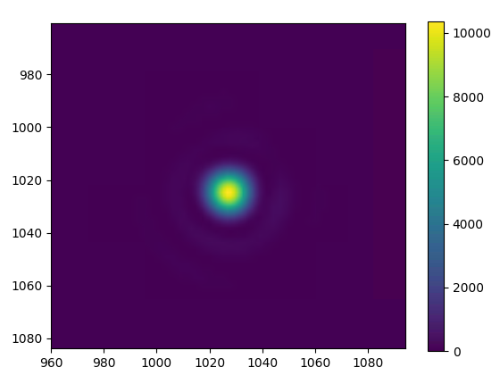
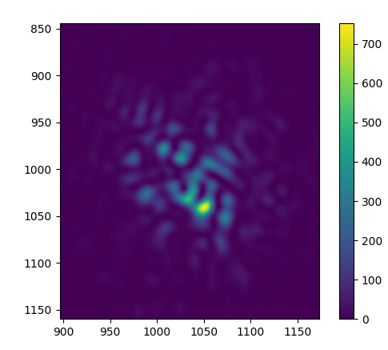
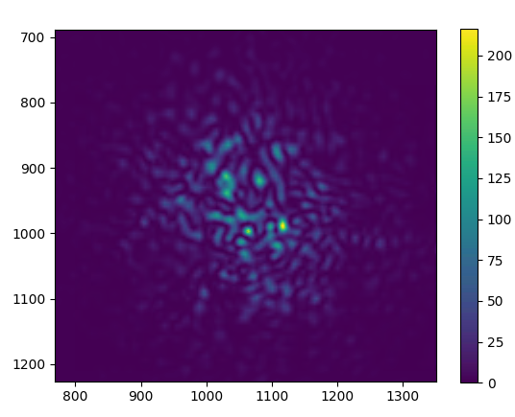
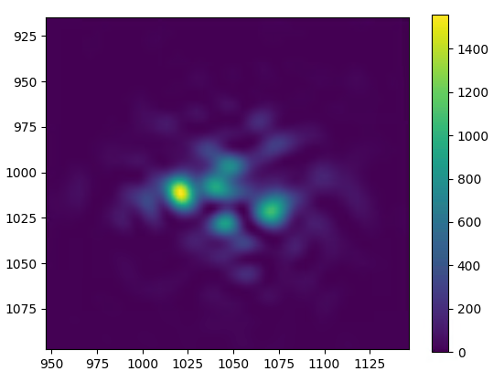
“Focused” Output
Ideal
D/r0 ~ 3
D/r0 ~ 15
D/r0 ~ 30

Slide 17
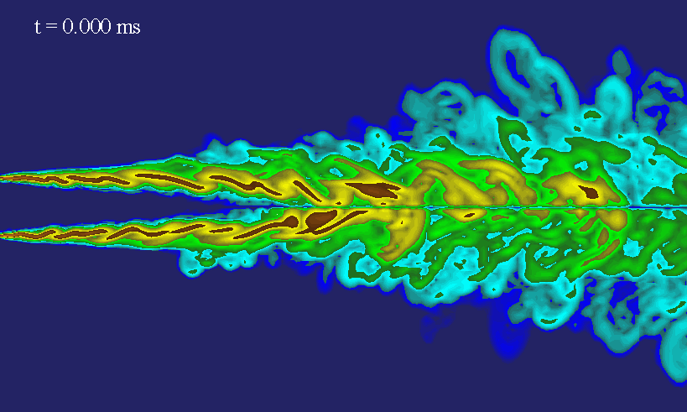
Temporal Phase Screens
Turbulence is a rapidly changing random process
Affected by wind (shifting), and chaotic adjustments over time (evolving)
Taylor’s Frozen Flow Model of Turbulence
Autoregressive Method

Slide 18
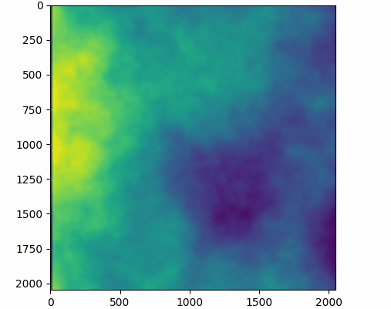
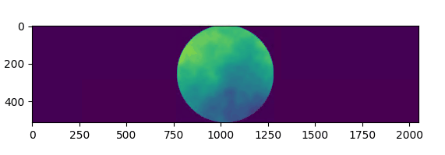
Taylor’s Frozen Flow Model
Shift the phase screens
Interpolation may be needed for non-integer multiples of grid spacing
Width becomes important to prevent wrapping
Rectangular phase screens

Slide 19
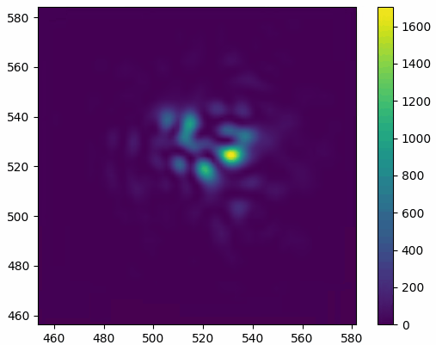
Propagation with Temporal Phase Screens
Shift phase screens
11 phase screens (2048x2048)
20km propagation
60 frames
30 seconds to generate – and still room for more parallelization

Slide 20
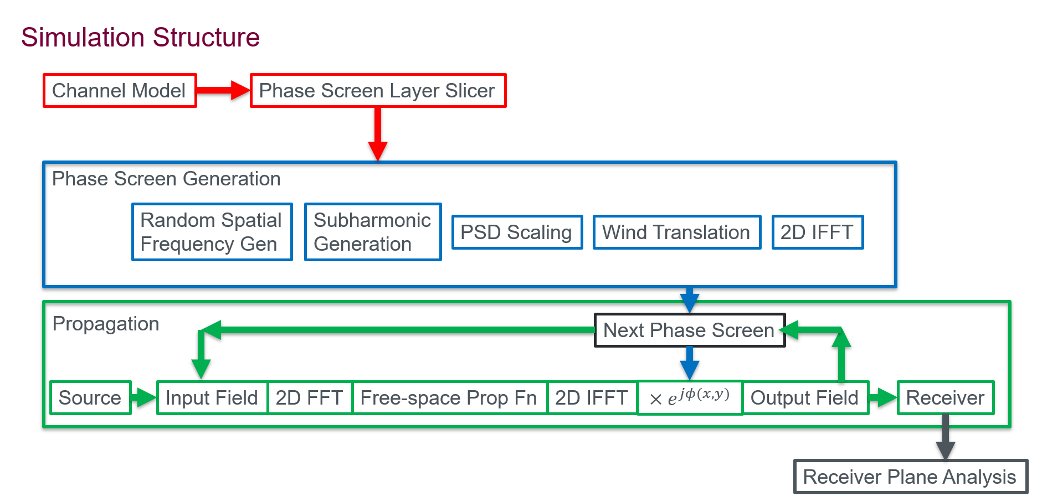

Slide 21
END
Thank you!

